Slide 1
Caustic Ingestion and Foreign Bodies of the Aerodigestive Tract
Dep. Of ENT
Prepared By: Dr. Natnael ORL Surgeon
Presented by: Dr. Abdisalam M.Musa

Slide 2
Caustic Ingestion
Esophagus, pharynx, larynx
Bases
  Drain cleaners
  Electric dishwasher soap
  Hair relaxant
Acids
Bleaches
Notes:
Esophageal, pharyngeal, and laryngeal injuries can occur from ingestion of acids, bases, and bleaches
Ingestion of bases causes the most severe injuries
Bases – drain cleaners, ammonia, detergents
Hair relaxers – no child proof packaging

Slide 3
Caustic Ingestion
Alkalis – pH > 7
  Liquefaction necrosis
Acids – pH < 7
  Coagulation necrosis
Bleaches – pH = 7
  Irritants
Notes:
Mechanism of injury differs
Liquefaction necrosis – loosening of tissue with deep diffusion into the tissue, only neutralization by the burning tissue will stop the reaction
Coagulation necrosis – formation of eschar which will limit the depth of burn
Bleaches are irritants and generally there is no serious morbidity

Slide 4
Caustic Ingestion
Amount
Type
Concentration
Time of contact
Notes:
Severity of burn determined by the type of substance, amount ingested, concentration of the substance, and the time of contact
Process of stricture formation can occur in one month or take many years

Slide 5
Caustic Ingestion
Initial management requires diagnosis
History
Obtain container
Poison control
Emesis?
Notes:
Initial management depends on accurate diagnosis
Careful history to find out what substance was ingested
Vomiting can increase the time of esophageal exposure

Slide 6
Caustic Ingestion
Laryngeal injury?
  Hoarseness, stridor, dyspnea
Severe injury?
  Odynophagia, drooling, refusal of food
Perforation?
  Chest pain, abdominal pain, rigidity
Notes:
Signs and symptoms not always reliable, some with relatively few symptoms can have severe injuries and vice versa

Slide 7
Caustic Ingestion
Neighboring injury
  Examination of lips, chin, hands, chest, clothing
Oropharynx
  Suction, lighting, restraint
Larynx/hypopharynx
  Flexible fiberoptic scope, mirror
Notes:
20% without oral burns have esophageal burns
70% with oral burns don’t have esophageal burns

Slide 8
Caustic Ingestion
Radiologic exam
  Chest & neck radiographs
Barium swallow
  Will not reveal 1st and 2nd degree injuries
Notes:
Associated airway distress? Foreign bodies?
Barium swallows not for acute management
Delays endoscopy

Slide 9
Caustic Ingestion
Esophagoscopy in virtually all patients at 24-48 hours post-ingestion
< 24 hours – underestimation of injury
> 48-72 hours with risk of iatrogenic perforation – barium swallow
Rigid vs. flexible debatable
Endoscopy to upper limit of severe burn
Notes:
Signs and symptoms are not entirely predictive of esophageal injury
48-72 hrs – structural weakness in esophageal wall

Slide 10
Caustic Ingestion
Grade 1 - superficial injury (hyperemic mucosa)
Grade 2 – transmucosal injury(mucosal ulceration)
Grade 3 – transmural injury (multiple ulcerations and extensive necrosis)
Circumferential vs. localized injury

Slide 11
Caustic Ingestion
Bleach ingestion
  5-6% sodium hypochlorite
  Produce ulceration
  Normal oropharynx – barium swallow
  Burned oropharynx - esophagoscopy
Notes:
Usually no permanent sequelae or stricture
Oropharyngeal burns present then treat as with other caustics

Slide 12
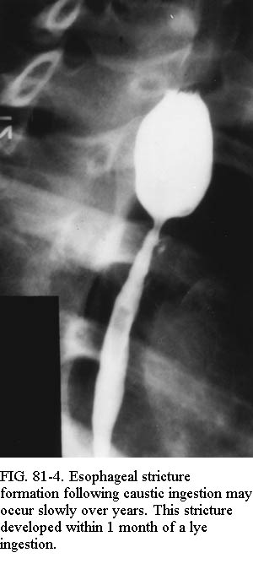
Caustic Ingestion
Goal
  Preventing permanent
  injury or stricture in
  esophagus

Slide 13
Caustic Ingestion
Antibiotics
Pro
  Decrease bacterial counts
  Reduction in granulation
Con
  Influx of gram negatives
  Mask infection
  No reduction in strictures
Ampicillin – 50 mg/kg/day

Slide 14
Caustic Ingestion
Steroids
Prednisone – 2 mg/kg/day x 21 days then taper
Most effective for grade 2 injuries
Strictures easier to manage
Notes:
Started within 8 hours, esophagoscopy at 24-48 hrs, start immediately
Grade 1 – no stricture development, grade 3 – increased perforation risk during surgery
Animal studies show reduced inflammatory response, granulation, and stricture
Cardona and Daly
Holinger argues that Anderson showed clear positive trend, higher dose and increased numbers would have shown significance

Slide 15
Caustic Ingestion
Prevention of acid reflux
  H2 blockers
  Proton pump inhibitors

Slide 16
Caustic Ingestion
Lathyrogens
Prevent covalent cross-linking of collagen
  Pencillamine
  N-acetylcysteine
Notes:
May be possible to prevent dense scarring or soften established scarring
Dog and rat models

Slide 17
Caustic Ingestion
Nasogastric tube
Esophageal stent
Prevent adherence of anterior and posterior walls of esophagus
Notes:
Under fluoro in first 24 hrs or during endoscopy
Wijburg used in 32 pts – only 2 developed strictures

Slide 18
Caustic Ingestion
Strictures develop in 10-15%
Dilation
  Prograde
  Retrograde
  Balloon catheters
Esophageal replacement

Slide 19
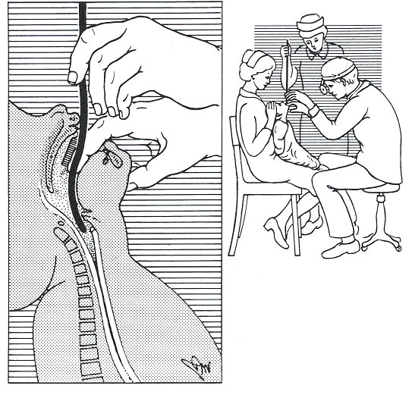
Caustic Ingestion
Prograde dilation
  Jackson silk-woven bougies
  Hurst dilators
  Maloney dilators
Notes:
Jackson under direct vision with general anesthetic
Hurst/Maloney can be used in awake patient
Until largest can’t pass, every few wks until satisfactory caliber, then prn, barium swallows

Slide 20
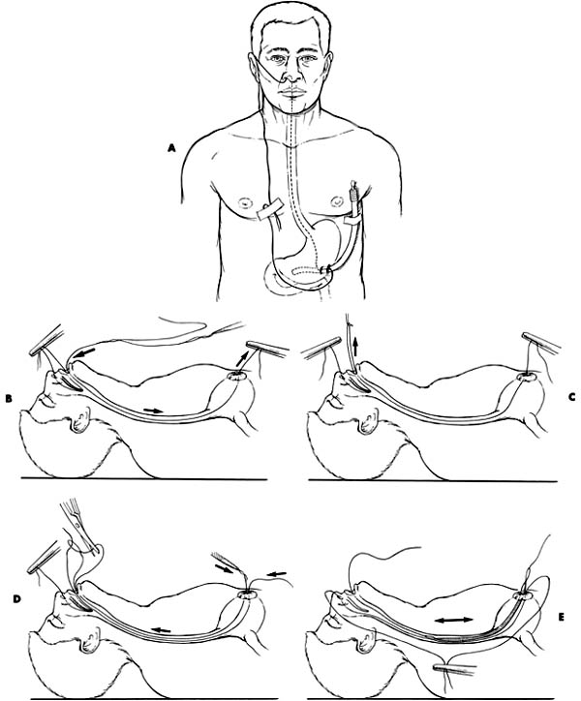
Caustic Ingestion
Retrograde dilation
  Safer?
  Tucker dilators
Notes:
Done daily in awake patient, can continue in prograde fashion

Slide 21
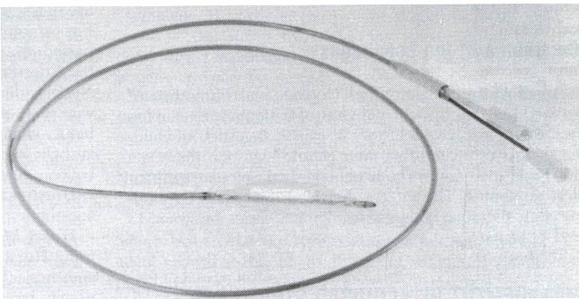
Caustic Ingestion
Gruntzig balloon catheter
Radial direction of dilation
Notes:
Radial less likely to tear esophagus than longitudinal dilation
Similar to angioplasty, balloon inflated under radiography

Slide 22
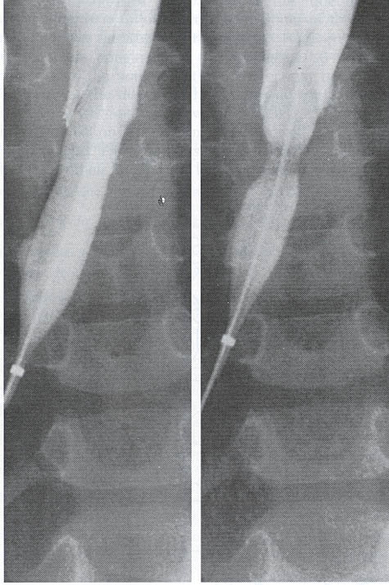
Caustic Ingestion

Slide 23
Caustic Ingestion
Esophageal replacement
Colonic interposition
Jejunal interposition
Gastric pull-ups
Notes:
Gastric pull-ups less likely in children
Most by colonic interposition

Slide 24
Caustic Ingestion
Esophageal carcinoma
1,000x increased risk
13 to 71 years after injury
Better prognosis than usual esophageal cancer
Notes:
Patient with worsening dysphagia years after caustic injury worrisome for cancer
Less distant metastasis in these patients

Slide 25
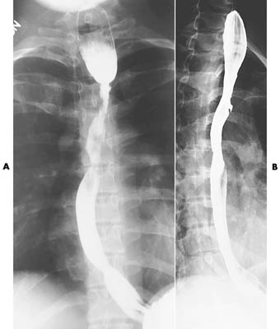
Caustic Ingestion
Notes:
Esophageal stricture before and after dilation

Slide 26
Foreign Bodies
Foreign body ingestion
Foreign body aspiration
Toddlers
  Oral exploration
  Lack posterior dentition
  Easy distractibility
  Cognitive development (edible?)
Notes:
4th leading cause of accidental death in 1-3 yo, 3rd leading cause of accidental death in those below one year
Twice as common in boys

Slide 27
Foreign Body Ingestion
Coins – 75%
Meat
Vegetable matter
Less than 24 hours in most
Notes:
Meat and vegetable matter less common in children – more in adults
Esophageal anomalies found in pts with recurrent impactions

Slide 28
Foreign Body Ingestion
Parental suspicion
Symptoms
  Choking, coughing, dysphagia, odynophagia
Physical exam
  Drooling, refuses p.o., fussy child
Respiratory compromise
Notes:
Choking/coughing – aspiration?
Sx of resp compromise in 10% due to compression of trachea

Slide 29
Foreign Body Ingestion
Common locations
  Cricopharyngeus
  Aorta/left mainstem bronchus
  Gastroesophageal junction
Notes:
Most lodge at C6 or cricopharyngeus

Slide 30
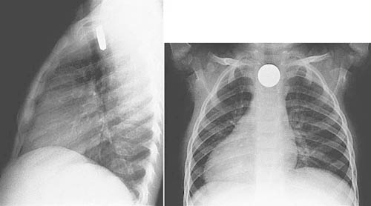
Foreign Body Ingestion
Radiopaque
  Coins
  Cartilage/bones
Radiolucent
  Hot dogs
Barium swallow
Notes:
Undigested meat/chicken
Hot dogs – most common object causing fatality due to airway impaction and obstruction
Barium swallow may outline radiolucent object

Slide 31
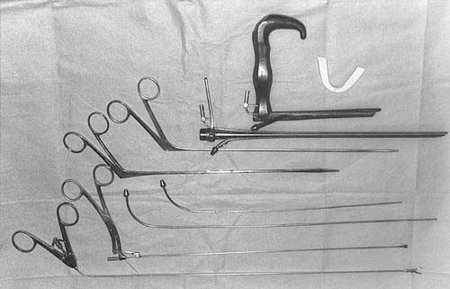
Foreign Body Ingestion
Removal
  General anesthesia
  Intubated
  Esophagoscopy
  Examine for ulceration/perforation
Notes:
Direct laryngoscopy can remove some at cricopharyngeus
Multiple FB in 5%
If pushed into stomach, stop to avoid esophageal trauma (exceptions – needles and safety pins)

Slide 32
Foreign Body Ingestion
Disc batteries
  Emergency
  NaOH, KOH, mercury
    1 hour – mucosal damage
    2 to 4 hours – muscular layers
    8 to 12 hours – perforation
  Esophagoscopy
  Observation for gastric location for 4-7 days
  Laparotomy for bowel perforation
Notes:
Can leak around grommett seal of battery
TE fistula, mediastinitis, stricture are all potential complications
If in stomach – send home with parents checking stools, xray in 4-7 days, endoscopy if in stomach

Slide 33
Foreign Body Ingestion
The most widely used methods include flexible endoscopy and rigid esophagoscopy.
Notes:
Controversial
Foley catheter passed beyond obstruction, child turned head down, and pulled out
Potential to convert stable esophageal FB to one with compression of trachea of obstruction of larynx

Slide 34
Flexible endoscopy is today the technique of choice given its effectiveness and the possibility ofperformed under sedation, avoiding the use of general anesthesia

Slide 35
The main indication for rigid esophagoscopy is failure of flexible endoscopy, which corresponds basically to sharp foreign bodies embedded in the mucosa and located in or near Killian's mouth

Slide 36
Foreign Body Aspiration
Vegetable matter in 70-80%
  Peanuts & other nuts (35%)
  Carrot pieces, beans, sunflower & watermelon seeds
Metallic objects
Plastic objects
Notes:
Metallic FB have decreased with increased use of disposable diapers – less safety pins
Plastics are relatively inert so can remain in the airway for extended periods of time

Slide 37
Foreign Body Aspiration
Bronchi – 80-90%
  Right mainstem most common
    Less divergent angle
    Greater diameter
    and it is argued that the bronchi is a continuation of the trachea
Trachea
Larynx
    Larger objects, irregular edges
    Conforming objects
Notes:
Size and configuration cause most to end up in peripheral bronchi
Carina to left of midline which is most important reason that most are seen in right

Slide 38
Foreign Body Aspiration
History
    Choking
    Gagging
    Wheezing
    Hoarseness
    Dysphonia
Can mimic asthma, croup, pneumonia
“A positive history must never be ignored, while a negative history may be misleading”
Notes:
Physical exam and xrays can be normal so the history is the most important aspect of diagnosis
Coughing and choking are most consistently seen, respiratory distress is relatively rare
Often unwitnessed and parents may minimize symptoms with resulting delay in diagnosis
Asthma in otherwise healthy child is suspicious as is recurrence of symptoms once therapy is discontinued

Slide 39
Foreign Body Aspiration
Choking episode with coughing, gagging or wheezing
Asymptomatic interval
  20-50% not detected for one week
Complications
  Cough
  Hemoptysis
  Pneumonia
  Lung abscess
  Fever
Notes:
Mucosa rapidly adapts to the presence of foreign bodies so signs and symptoms may be absent
3 stages
Possible complete airway obstruction during initial phase
Asymptomatic interval occurs when irritation subsides and reflexes fatigue, this accounts for delay in dx

Slide 40
Three phases bronchial in foreign body
Aspiration or penetration phase
Fixation or interlocking phase
Complications phase

Slide 41
Foreign Body Aspiration
Physical exam
  Larynx/cervical trachea
    Inspiratory or biphasic stridor
  Intrathoracic trachea
    Prolonged expiratory wheeze
  Bronchi
    Unequal breath sounds
    Diagnostic triad - <50%
      Unilateral wheeze
      Cough
      Ipsilaterally diminished breath sounds
Fiberoptic laryngoscopy
Notes:
Signs can be subtle
5-40% have normal physical exam
Flexible fiberoptic laryngoscopy can rule out laryngomalacia or other nontraumatic etiologies

Slide 42
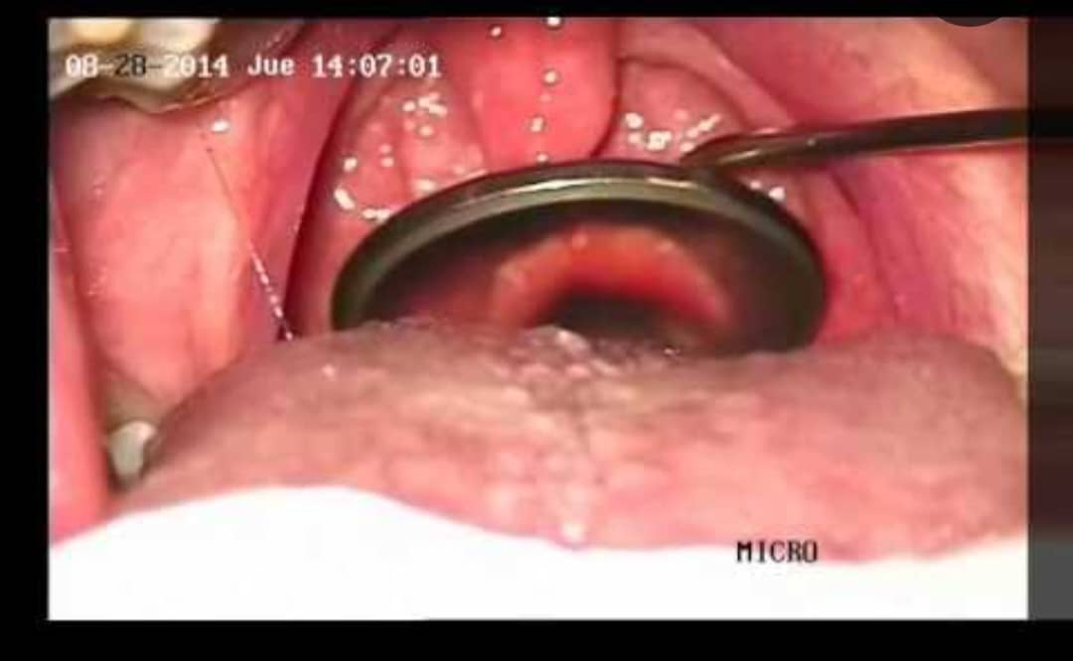

Slide 43
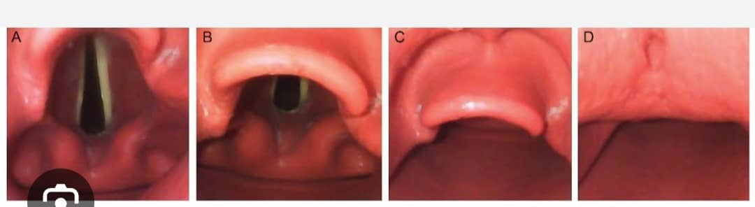
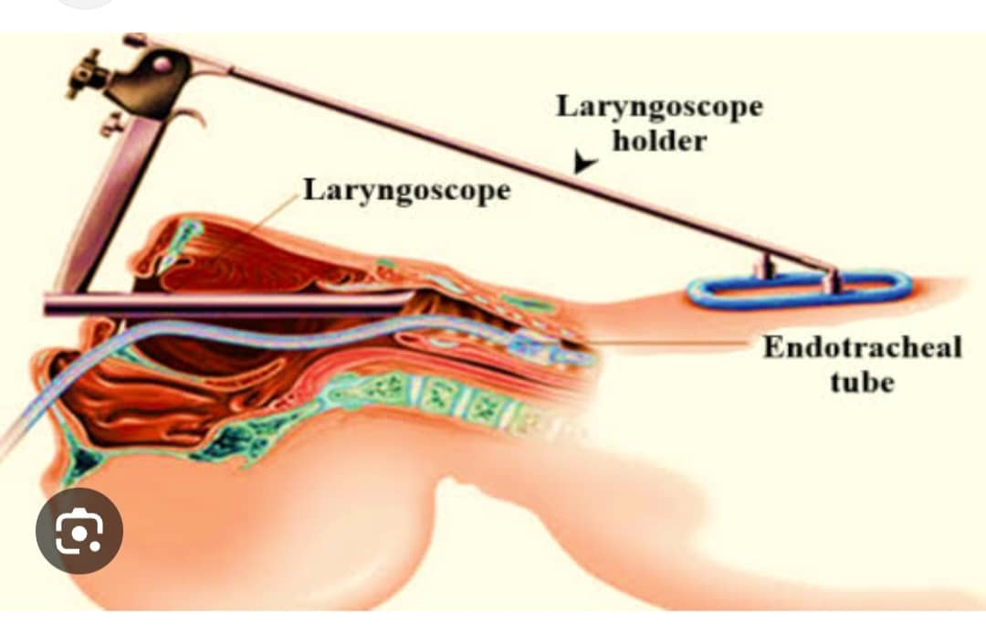

Slide 44
Foreign Body Aspiration
Radiography
  PA & lateral views of chest & neck
  Inspiration & expiration
  Lateral decubitus views
  Airway fluoroscopy
25% have normal radiography
Notes:
Radiopaque FB easily seen with xray
Radiolucent FB (the majority) may have obliterated bronchial air column, atelectasis, mediastinal shifts, or air-trapping in the affected lung
Inspiratory hypoinflation and expiratory hyperinflation in hallmark of bronchial FB
Decubitus films – dependent lung should collapse but will remain inflated if FB

Slide 45
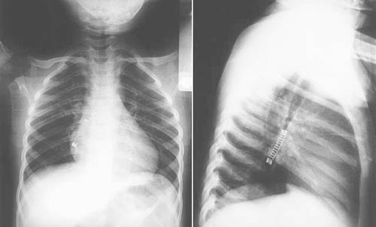
Foreign Body Aspiration
Notes:
Radiopaque – spring in right mainstem bronchus

Slide 46
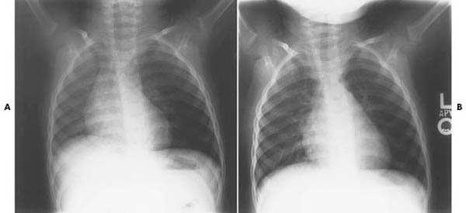
Foreign Body Aspiration
Notes:
Radiolucent – left mainstem obstruction

Slide 47
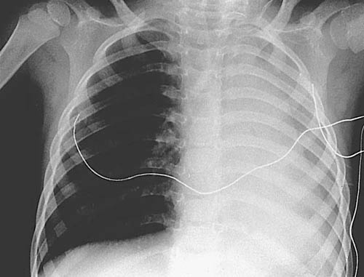
Foreign Body Aspiration
Notes:
Left mainstem – left lobe consolidation
Usually from delayed dx

Slide 48
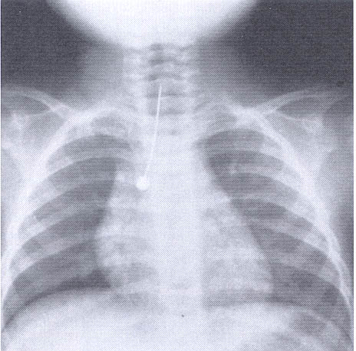
Foreign Body Aspiration
Notes:
Pin in trachea

Slide 49
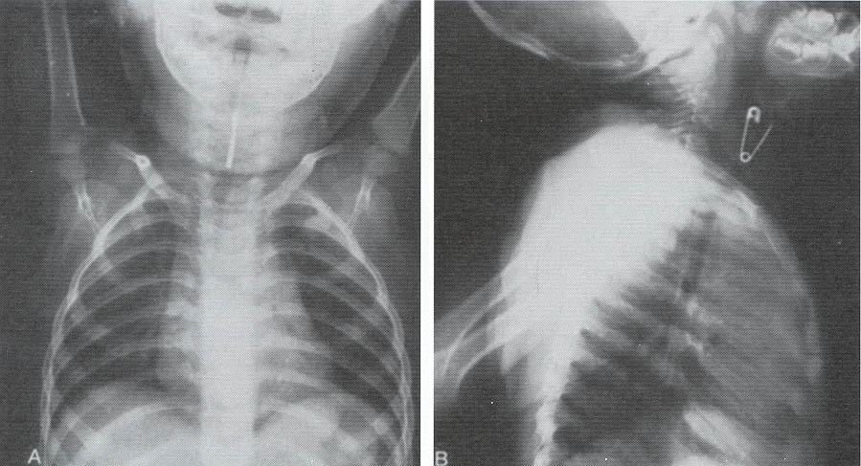
Foreign Body Aspiration
Notes:
Safety pin in larynx

Slide 50
Foreign Body Aspiration
Goal
Prompt endoscopic removal under conditions of maximal safety and minimal trauma
Notes:
Not nesesarily a true emergency

Slide 51
Foreign Body Aspiration
Complete airway obstruction
  Respiratory distress
  Inability to speak or cough
Partial airway obstruction
  Coughing
  Gagging
  Throat clearing
  Back blows/probing hypopharynx not recommended
Notes:
Very important to recognize complete airway obstruction vs. partial airway obstruction
Blindly probing hypopharynx can convert to complete obstruction

Slide 52
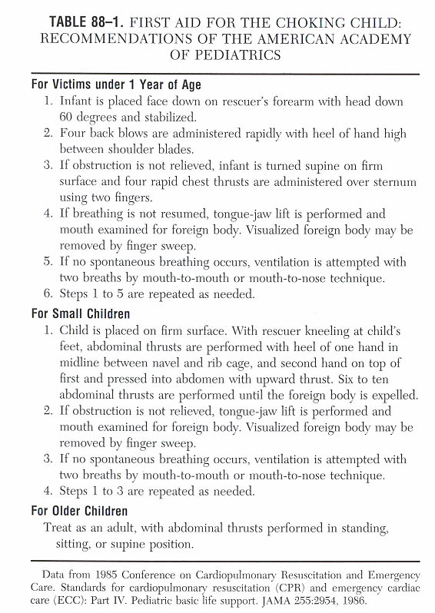
Foreign Body Aspiration

Slide 53
Foreign Body Aspiration
Usually NOT A DIRE EMERGENCY
  Trained personnel
  Instruments assembled and checked
  Await for emptying of stomach
  Find duplicate FB to test instruments and techniques
Notes:
Majority of patient have passed acute phase by the time of otolaryngologic evaluation
So is NOT A DIRE EMERGENCY

Slide 54
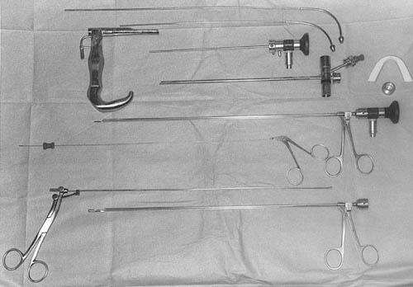
Foreign Body Aspiration
General anesthesia
Spontaneous ventilation
Laryngoscopes
Bronchoscopes
Suction
Forceps
Rod-lens telescopes
Notes:
Age matched appropriate bronchoscopes and a size smaller in case edema or stenosis is encountered

Slide 55
Foreign Body Aspiration
Ready to assume airway during induction
Laryngoscopy
  Examination of upper airway
  Atraumatic insertion of bronchoscope
  Topical anesthesia
Bronchoscopy
  Attached to ventilating circuit
Notes:
Ready to assume airway during induction if ventilation becomes impaired

Slide 56
Foreign Body Aspiration
Bronchoscopy
  Suction opposite bronchus
  Advance to foreign body
  Atraumatically grasp foreign body
  Repeat bronchoscopy
    Suction bronchus
    Multiple foreign bodies in 5-19%
  Remove granulation tissue
  Topical vasoconstrictors for bleeding
Notes:
Suction opposite bronchus to improve oxygenation
Smaller objects pulled through bronchoscope
Larger objects pulled snugly against bronchoscope and removed as one unit

Slide 57
Foreign Body Aspiration
Complications
  Pneumonia
    Antibiotics, physiotherapy
  Atelectasis
    Expectant management, physiotherapy
  Pneumothorax
  Pneumomediastinum
Notes:
Persistence of pneumonia or atelectasis symptoms beyond one week must make you consider retained FB

Slide 58
Foreign Body Aspiration
Postoperative Care
  Chest physiotherapy for retained secretions
  Antibiotics
    Not routinely used
  Steroids
    Not routinely used
    Traumatic insertion or removal

Slide 59


Slide 60


Slide 61
Next Monday
Abscesses in ENT: retropharyngeal, parapharyngeal, Ludwig’s angina, septal abscess

